Slide 1
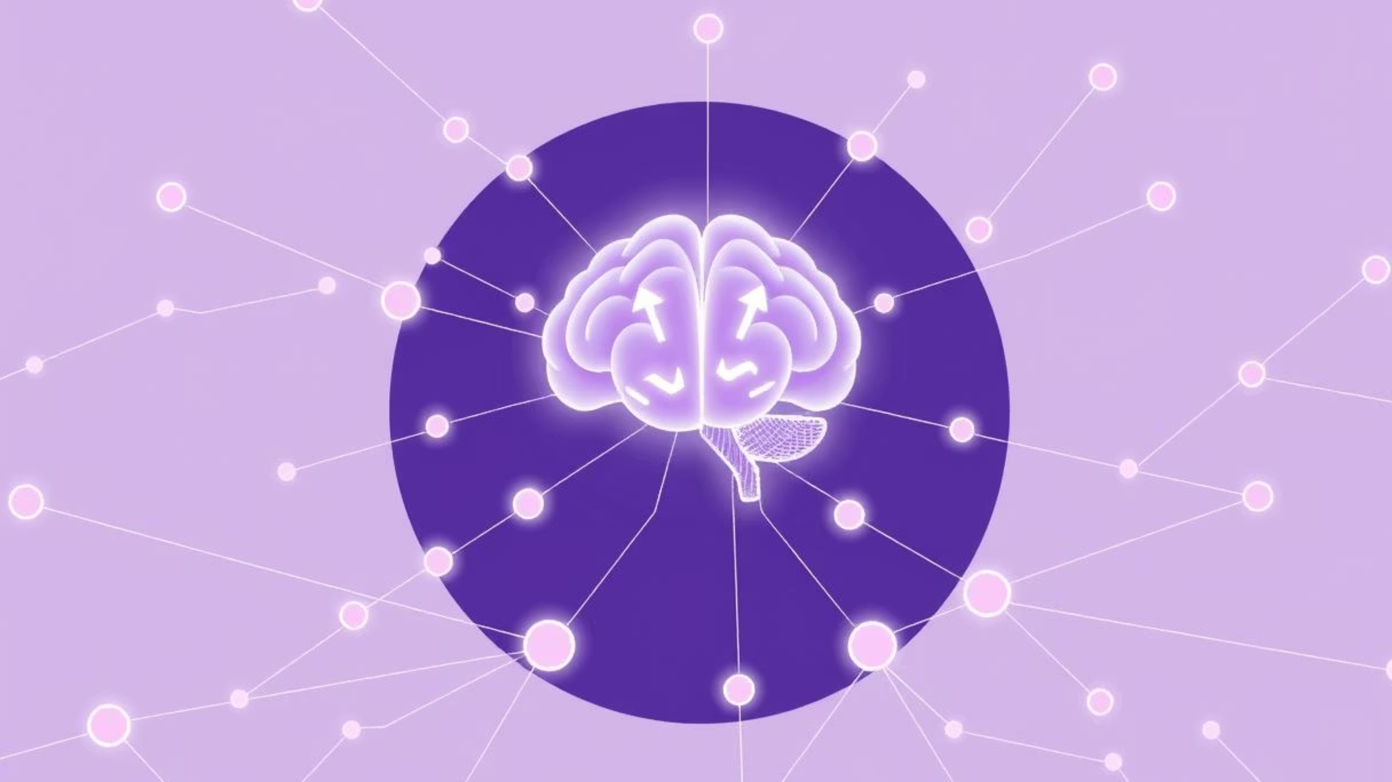
HR ANALYTICS: EMPLOYEE PROMOTION PREDICTION
A Machine Learning–Powered HR Promotion Prediction System
Developed as part of Teks Academy Training Institute
Trainer: Mohd Hameed
Project by: Ayesha Banu
Objective: Showcase data-driven HR decision-making for fairer, smarter promotions.

Slide 2

Why AI for Promotions?
Promotions are among the most critical decisions in HR management. Traditionally, they rely on managerial judgment, which carries inherent risks of bias and inconsistency.
With today's large employee datasets, manual evaluation is simply impossible to scale or maintain fairly.
This project leverages Data Science & Machine Learning to accurately predict promotions, providing transparency and explainability to support HR managers with evidence-based decisions.

Slide 3


The Problem: Bias & Inconsistency
Subjectivity & Bias
Lack of Scalability
Promotion decisions often suffer from inconsistency and high risk of bias (gender, department, tenure).
Without a structured system, manual processes are slow, error-prone, and cannot scale across large organizations.
Employee Dissatisfaction
The result is often reduced organizational trust in HR and increased employee dissatisfaction leading to attrition.

Slide 4

Our Objectives: Fairer, Smarter Promotions
Primary Goal
Predict which employees are most likely to be promoted based on objective criteria.
Sub-Goals
Identify key drivers of promotion (training score, KPI achievement, tenure, etc.).
Provide explainable AI insights using SHAP for transparency.
Build a user-friendly dashboard for HR decision-makers.
Expected Outcomes
Smarter, more equitable promotion decisions.
Improved employee motivation and retention.

Slide 5
Practical Application: How HR Uses It
System Capabilities
Business Value
Single Prediction: Check promotion eligibility for an individual employee.
This system will significantly reduce bias, enhance transparency, and foster trust, ultimately leading to improved employee satisfaction and retention.
Batch Predictions: Upload a CSV for promotion likelihood across many employees.
Explainability: Understand factors influencing each decision via SHAP.
Dashboard Insights: Analyze promotion rates by department, education, KPI status, and more.

Slide 6
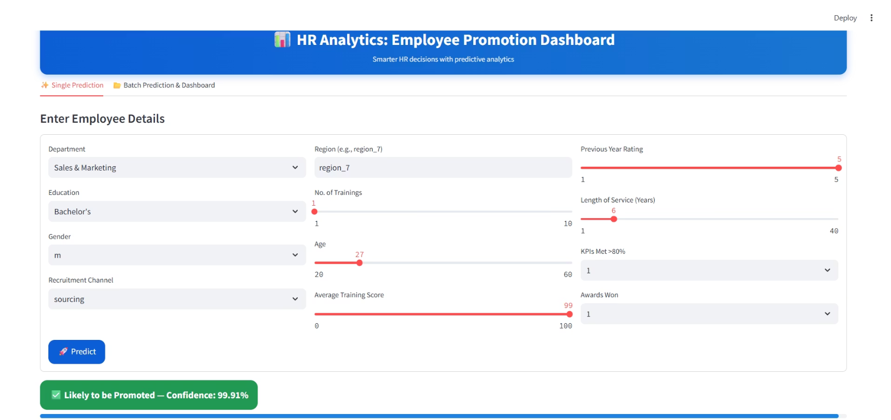
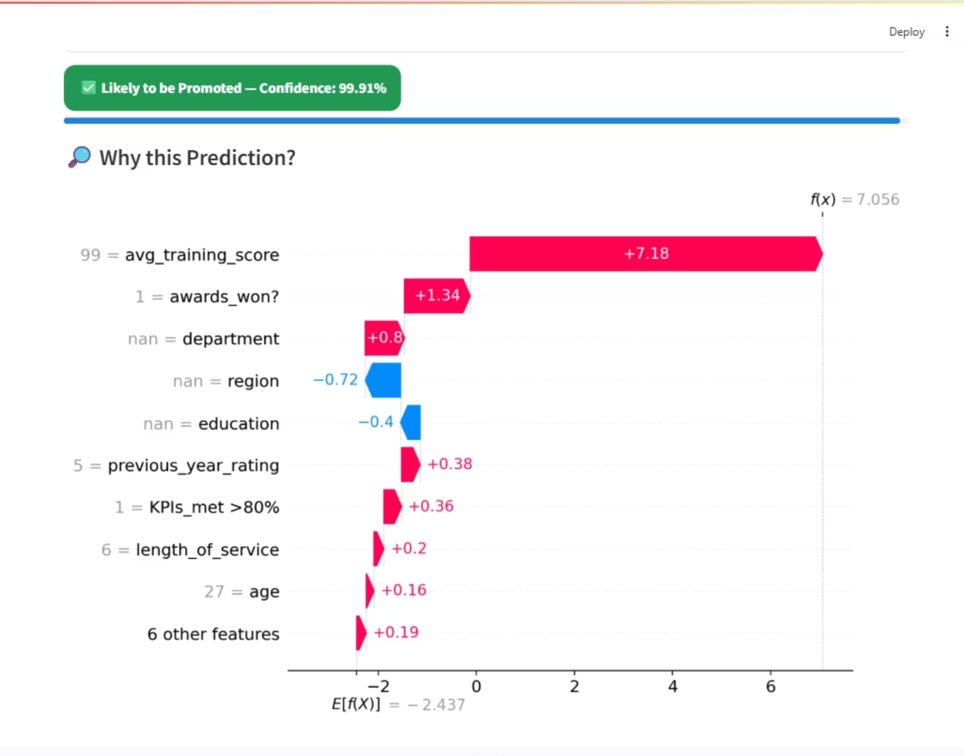
Streamlit Application: Single Prediction

Slide 7
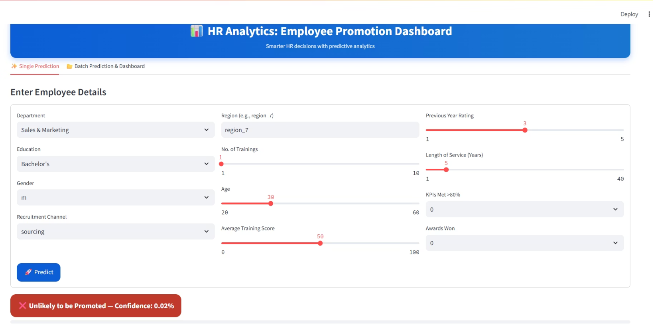
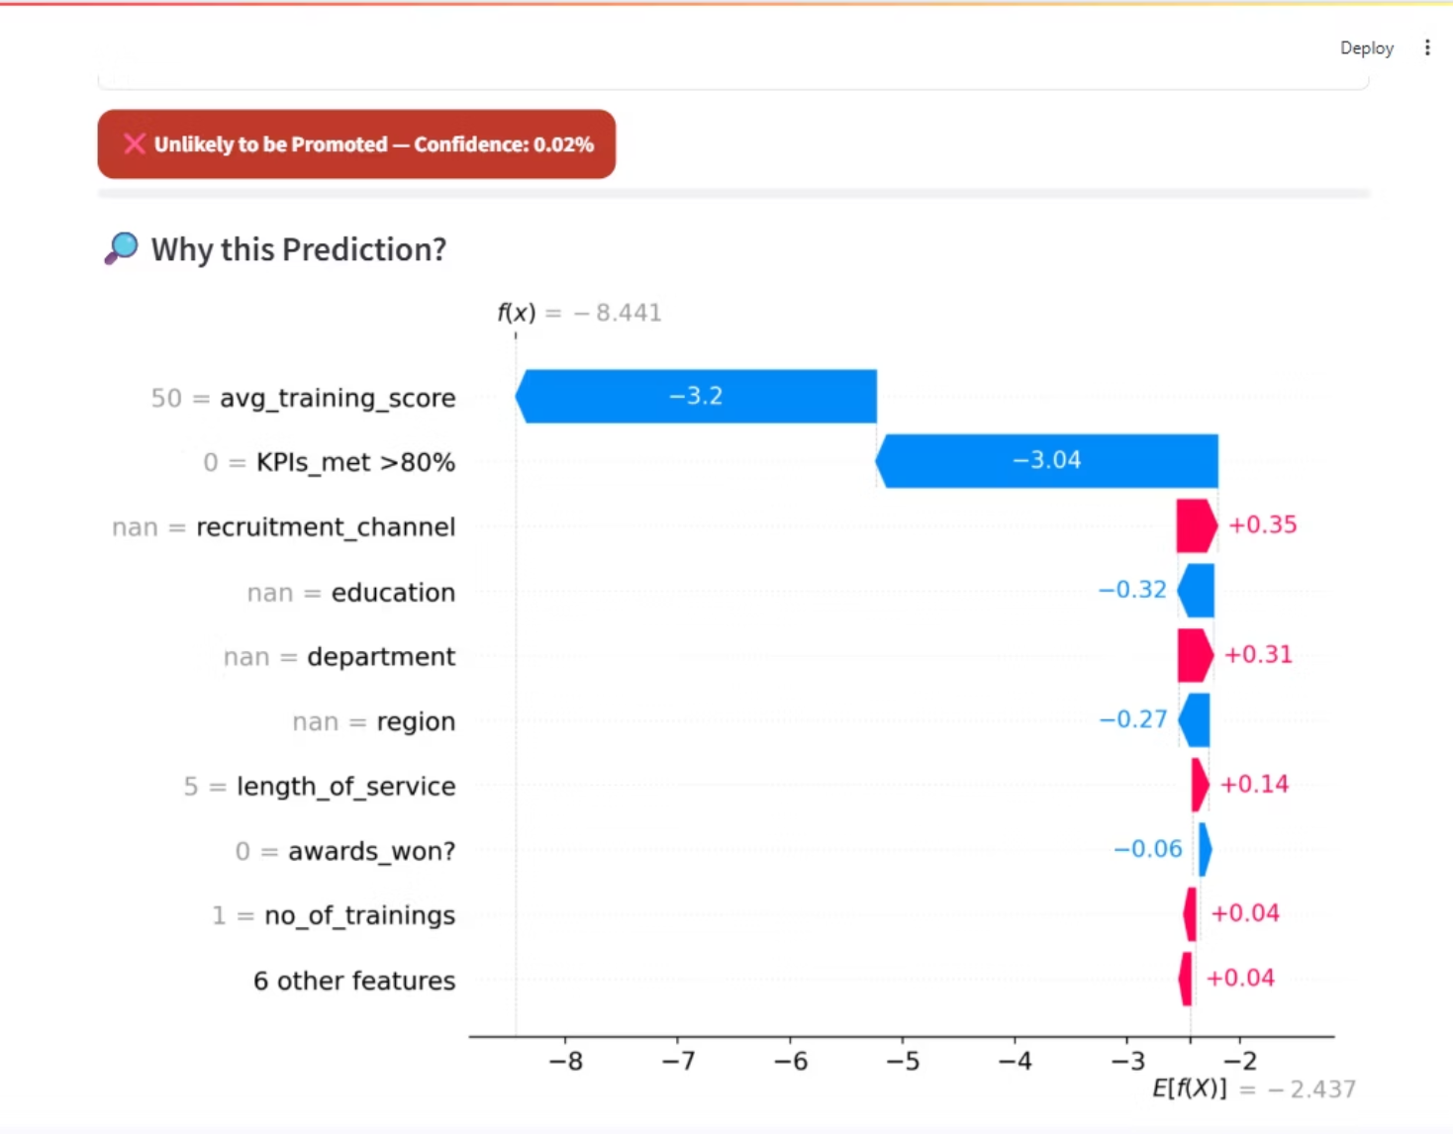

Slide 8
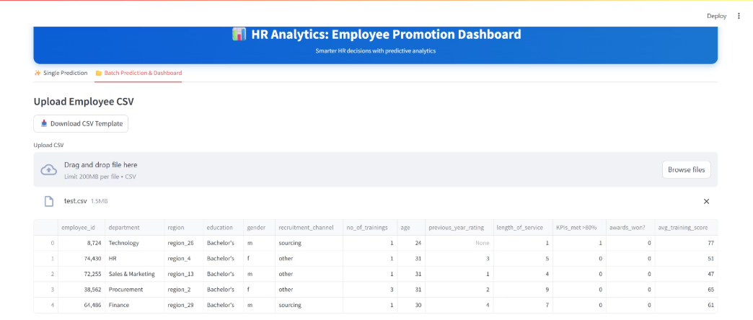
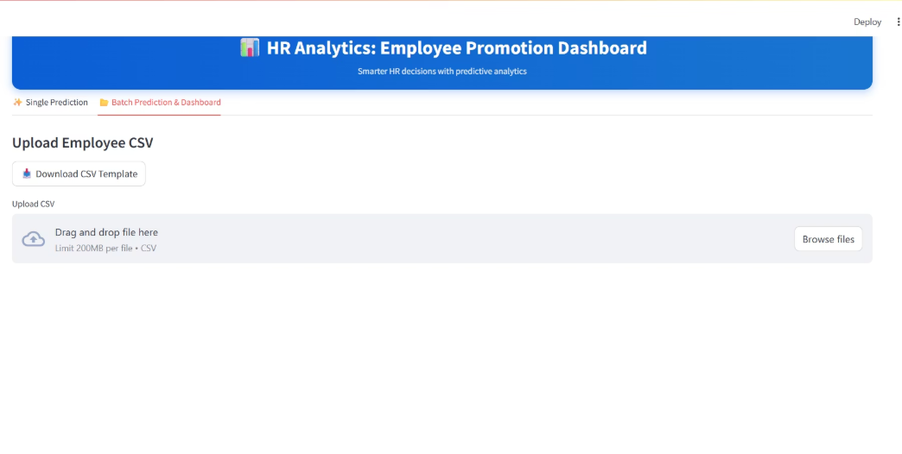
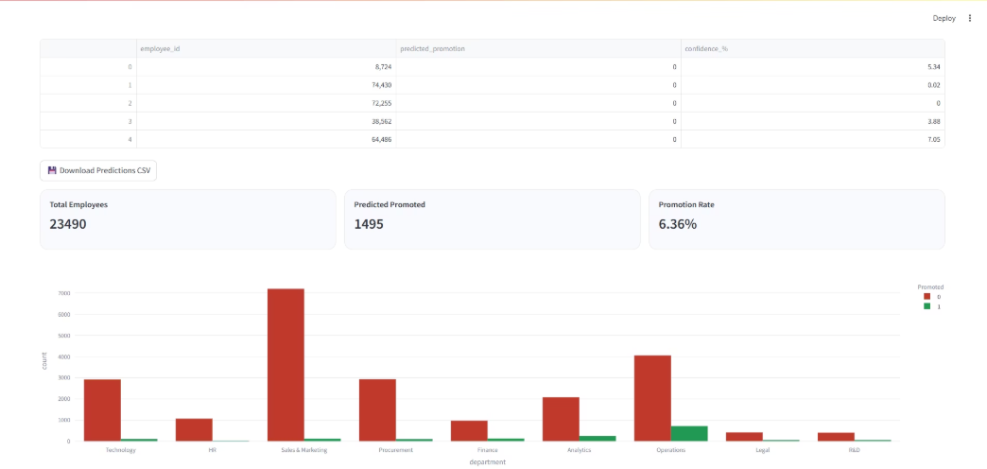
Streamlit Application: Batch Prediction

Slide 9
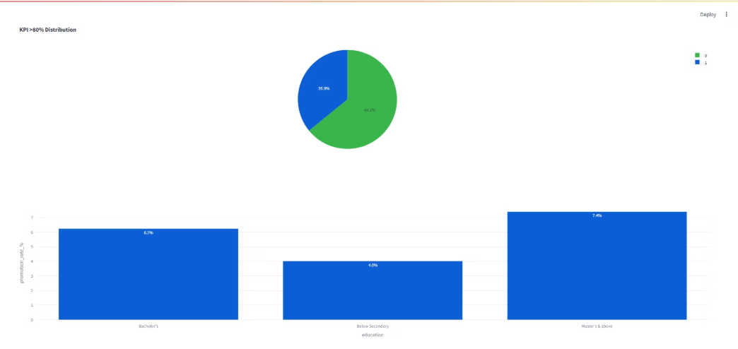
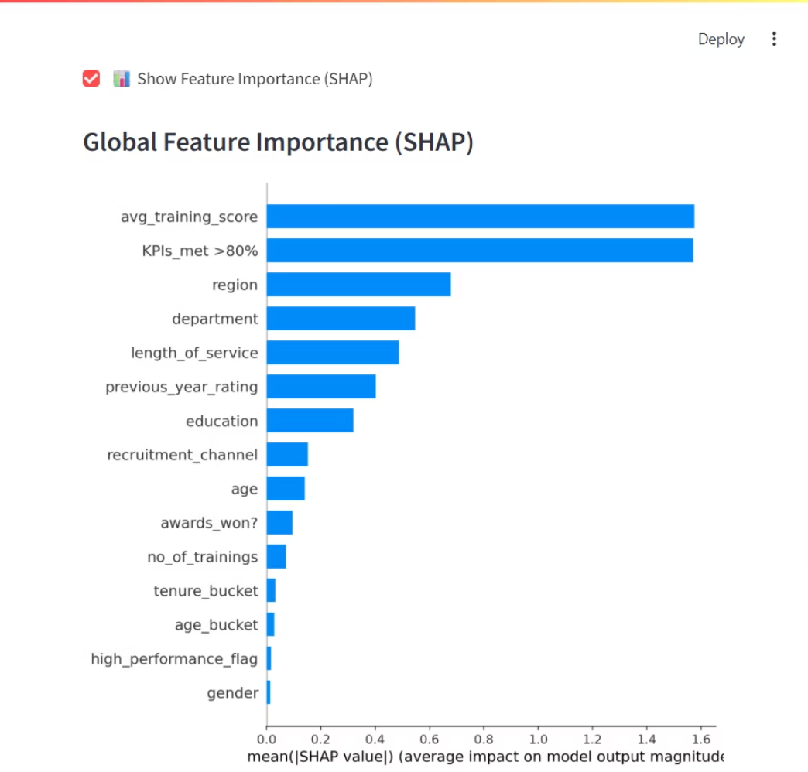
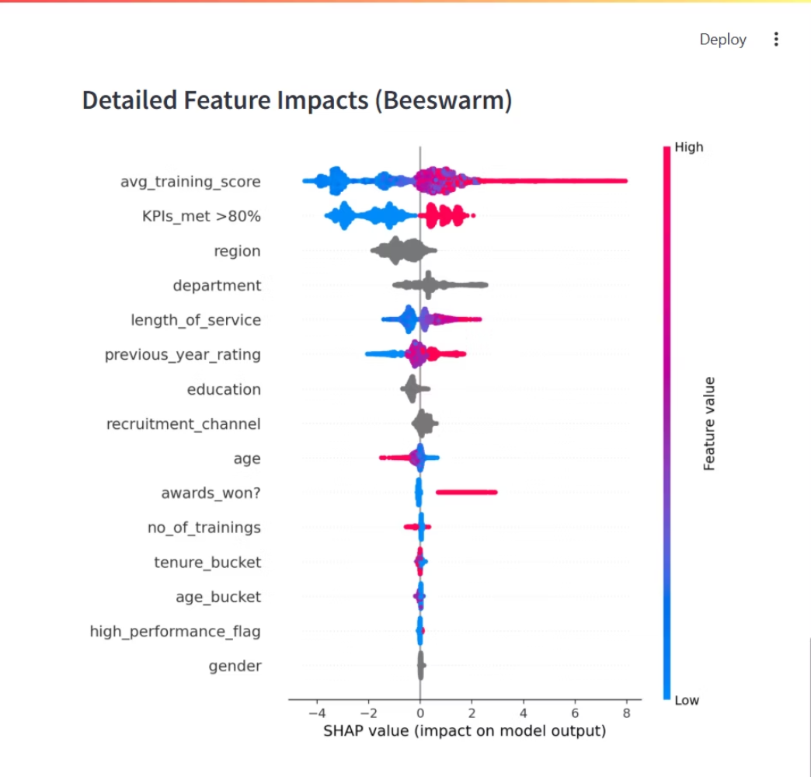

Slide 10

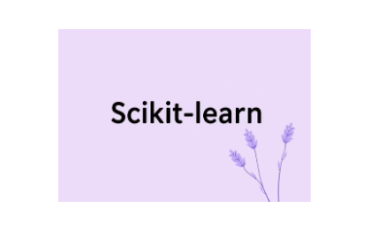
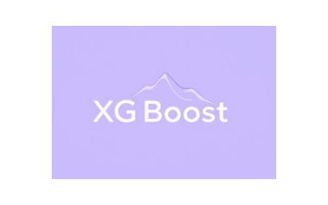


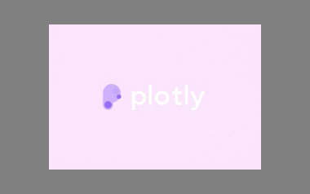
Powerful Tools & Technology Behind It
Core Stack
Deployment & Visualization
Python: Data Science backbone
Streamlit: Interactive HR dashboard development
Pandas, NumPy: Data preprocessing & manipulation
Plotly: Dynamic visual analytics
Scikit-learn: Machine Learning models
Joblib: Model persistence for efficient loading
XGBoost, Random Forest: Advanced predictive models
SHAP: Explainable AI (XAI)

Slide 11
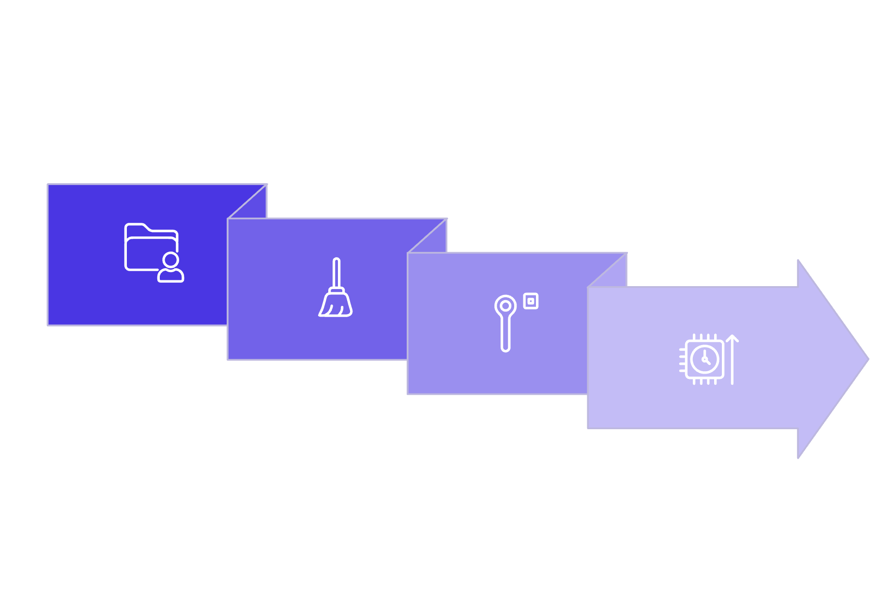




Project Architecture: End-to-End Workflow
Preprocessing
Model Training
Data Collection
Feature Engineering
This streamlined workflow ensures robust model development, transparent insights, and an intuitive user experience for HR professionals.

Slide 12


Dataset Overview
Key Features
Demographics: department, region, education, gender, recruitment_channel
Experience: no_of_trainings, age, previous_year_rating, length_of_service
Performance: KPIs_met >80%, awards_won?, avg_training_score
Target Variable
is_promoted (0 = Not Promoted, 1 = Promoted)
Size
Train: 54,808 employeesTest: 23,490 employees
This rich dataset allows for comprehensive analysis and accurate promotion predictions.

Slide 13
Feature Engineering: Unlocking Deeper Insights
1
2
3
Age Buckets
Tenure Buckets
High Performance Flag
Categorizing employees into Young, Mid, and Senior groups simplifies HR interpretation.
Classifying service length as New, Experienced, or Veteran highlights promotion by service milestones.
Combining KPIs met >80% and previous rating ≥4 creates a strong indicator for promotion.
These engineered features not only simplify HR reporting but also help our models capture hidden patterns and align with established business logic.

Slide 14
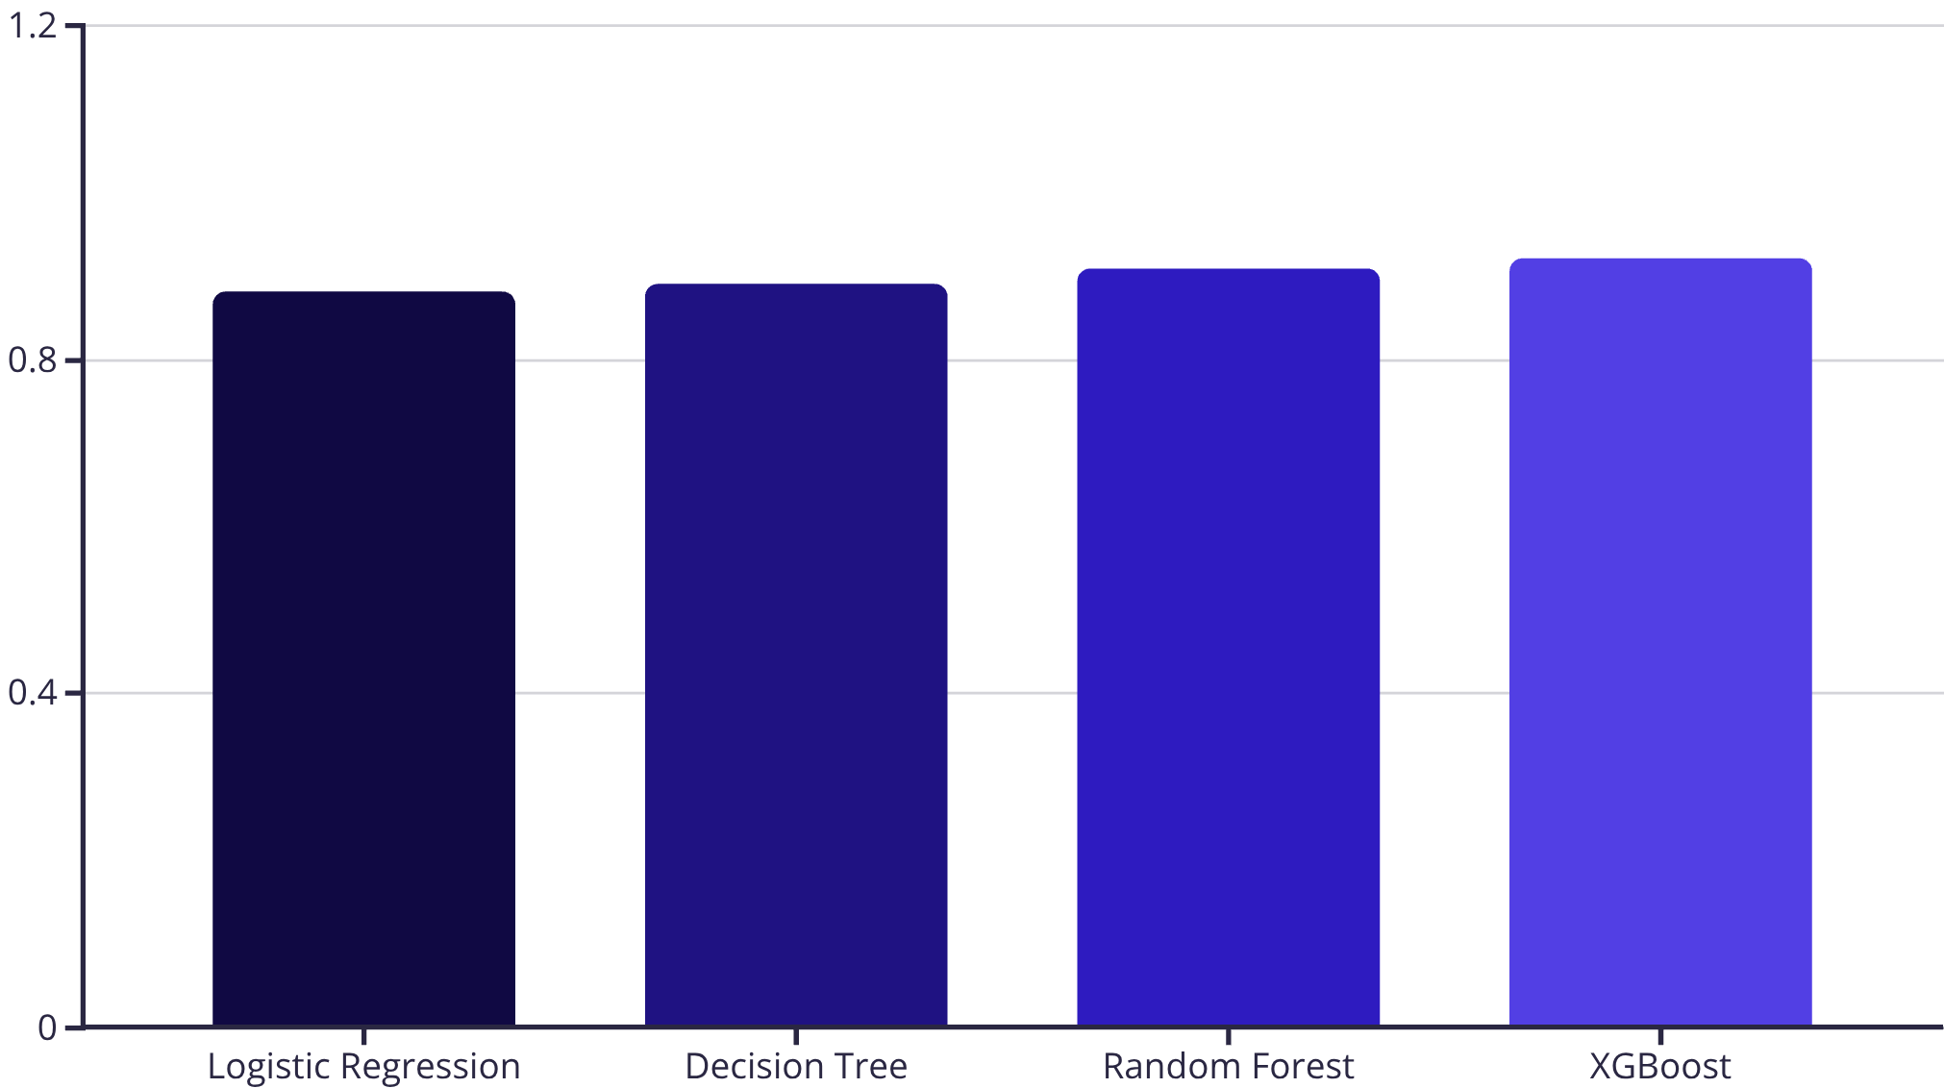
Model Training & Outstanding Results
Models Tested
Logistic Regression
Decision Tree
Random Forest
XGBoost
Best Performing Model
XGBoost achieved an impressive ~92% Accuracy, proving highly effective at handling imbalanced classes inherent in promotion data.
Evaluation Metrics
We rigorously evaluated models using Accuracy, Precision, Recall, F1-score, and cross-validation for robustness.

Slide 15
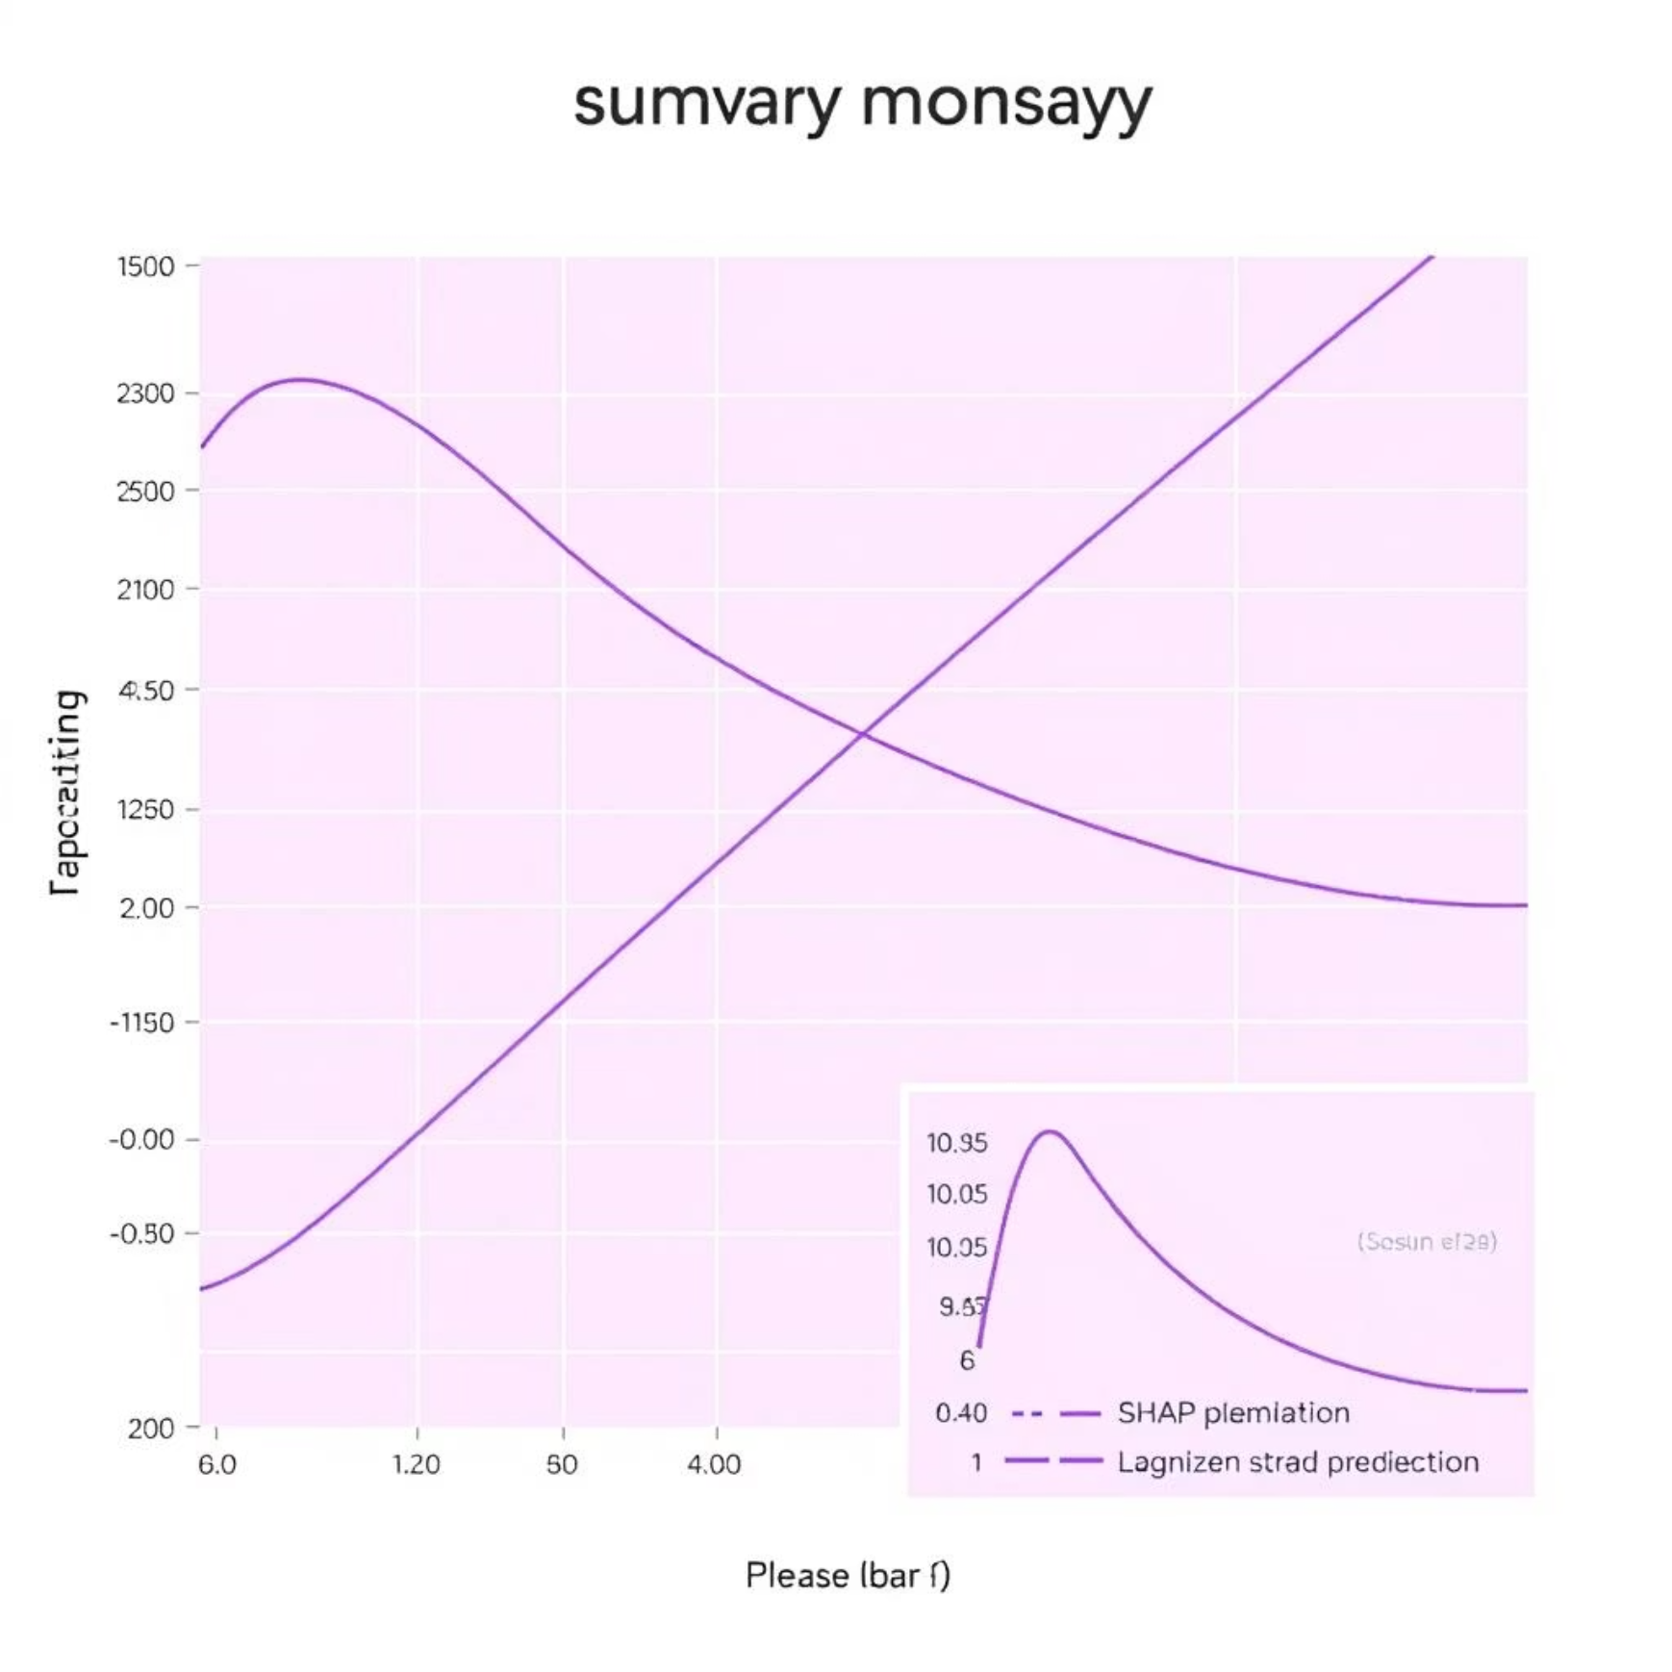
Explainability with SHAP
THE CORE OF TRANSPARENCY
SHAP Insights: Global and Local
Global Explanation: SHAP identifies the most influential factors across all predictions. For our HR model, average training score, achievement of key performance indicators (KPIs) above 80%, previous year's rating, and employee tenure emerged as the most important drivers of predictions.
Local Explanation: For each individual employee, SHAP provides a precise breakdown of how each input feature contributed to their specific prediction (e.g., why an employee was predicted to be "high potential" or "at risk").
Business Benefit: Trust and Clarity
This level of detail means HR managers can fully trust the model's recommendations, understanding the clear, transparent reasoning behind every decision, moving beyond a "black box" approach.

Slide 16

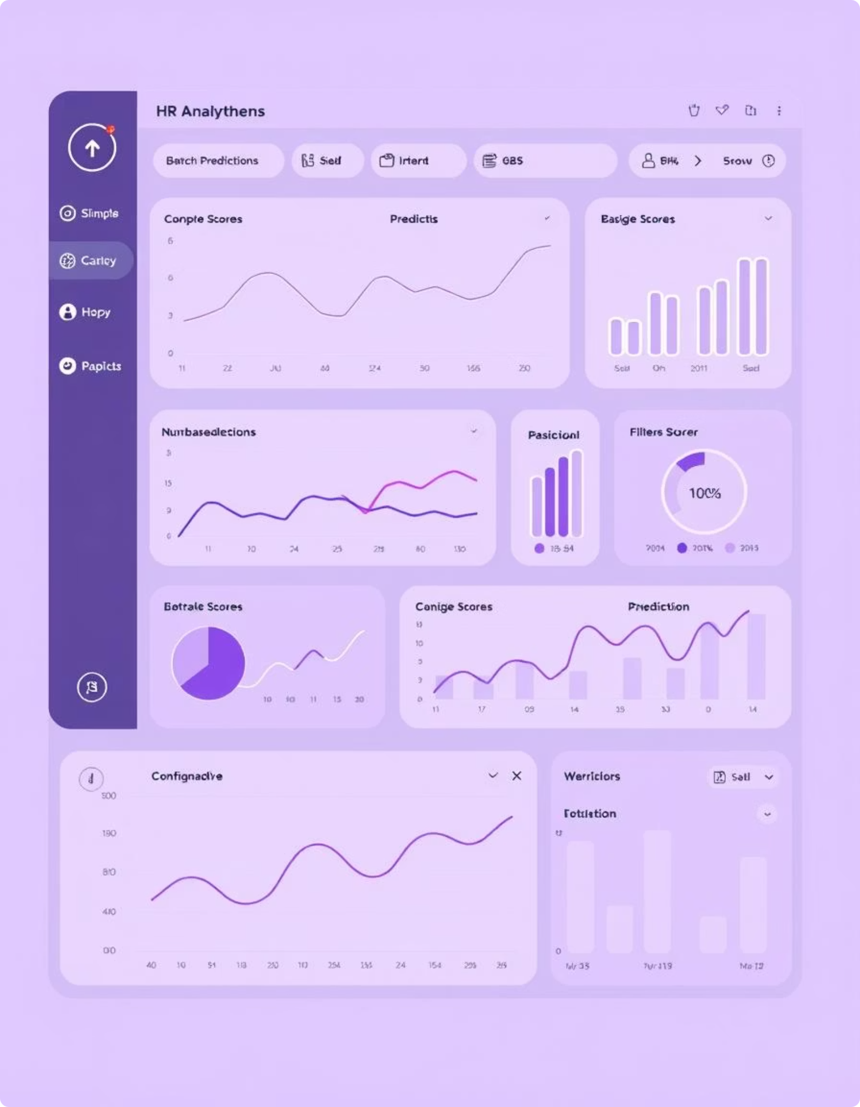
Interactive Insights Dashboard
EMPOWERING HR WITH DATA
Real-time Predictions
Execute single or batch predictions with immediate results, streamlining decision-making for HR teams.
Confidence & Explanation
Each prediction comes with a confidence score and a detailed SHAP explanation, providing full transparency on the underlying factors.
Interactive Analytics
Explore trends based on department, KPI achievement, education level, and other key demographics through intuitive, interactive visualizations.

Slide 17
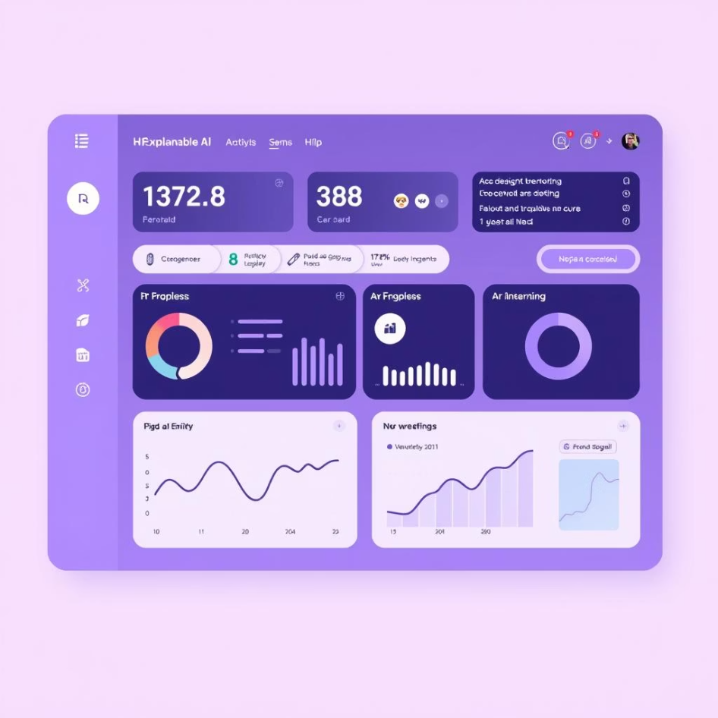
Transforming HR with Trust
LOOKING AHEAD
Our Solution Delivers:
A smart, fair, and explainable HR ML system.
Reduced algorithmic bias in HR processes.
Improved transparency and understanding.
Enhanced employee trust and engagement.
Ready for seamless integration with existing HRMS systems.

Slide 18

Thank You
Questions & Discussion
We are excited to discuss how Explainable AI can revolutionize your HR practices.

